Slide 1


GROUP II
SIGNIFY:A SIGN LANGUAGE TRANSLATION APP
Department of CSE
Sahrdaya College of Engineering & Technology
Kodakara
1
Notes:
1
1
1
1
1

Slide 2

GROUP MEMBERS
1. Athul Krishna (221907)
2.Ashwin Joy (221729)
3.Indralal Shaiju T S (221301)
4.Sweeto Pauly (221761)
2
Notes:
2
2
2
2
2

Slide 3

CONTENTS
INTRODUCTION
OBJECTIVES
PROBLEM IT SOLVES
DIAGRAMS
METHODOLOGY
DATA GENERATION
TRAINING AND TESTING
IMPLEMENTATION
RESULTS
SOFTWARE/HARDWARE SPECIFICATION
CONCLUSION
FUTURE SCOPE
CSE Department, JECC
3
Notes:
3
3
3
3
3

Slide 4
1.INTRODUCTION
Hand gesture recognition is a subset of computer vision that focuses on recognizing meaningful human hand shapes or movements.
It is widely used in interactive systems for games, virtual reality, sign language recognition, robotics, and more.
With the rise of deep learning, hand-gesture recognition has become more precise and efficient.
CSE Department, JECC
4
Notes:
4
4
4
4
4

Slide 5
2.OBJECTIVES
To study and analyse the sign languages for different vocal languages and the algorithm to translate the signs including the movement based ones to text format.
To design a mobile or web application that translate a whole sentence from the user preferred sign language to text format and further to audio or speech format using GTTS engine.
We aim to bridge the communication gap with the hearing and speech-impaired, who make up 6.3% of the population.
CSE Department, JECC
5
Notes:
5
5
5
5
5

Slide 6
3.PROBLEM IT SOLVES
It would ease the difficulty while being in a conversation between deaf and mute people.
Usually both people should be knowing the sign language .
This helps to interact with them more easily without even learning sign language.

Slide 7
4.LITERATURE REVIEW
AUTHORS | TITLE | METHODOLOGY | INFERENCE
Sunusi Bala Abdullahi,Kosin Chamnongthai | “IDF-Sign: Addressing Inconsistent Depth Features for Dynamic Sign Word Recognition” | IDF-Sign uses a method called Pairwise Consistency Feature Ranking (PairCFR) to pick out the most reliable features from the video data, helping to reduce errors. | Addresses the challenge of inconsistent depth features by using a novel spatial-temporal multivariate pairwise consistency feature ranking approach, achieving state-of-the-art recognition performance on multiple sign language datasets.
Fransisco Morilla -Espejo, Ester Martines Martin | “Sign4all: A Low-Cost Application for Deaf People Communication” | Uses Convolutional Neural Network (CNN) to recognize the hand shapes from images. It’s been trained with lots of pictures of people signing, so it can accurately tell what letter is being signed. | Designed to facilitate communication for deaf people by recognizing Spanish Sign Language (LSE) through a deep learning-based sign language recognizer and a virtual avatar that interprets text into sign language.
CSE Department, JECC
7
Notes:
7
7
7
7
7

Slide 8
4.LITERATURE REVIEW
AUTHORS | TITLE | METHODOLOGY | INFERENCE
B. Natarajan, E. Rajalakshmi, R. Elakkiya, Ajith Abraham, Ketan Kotecha, Lubna Abdelkareim Gabralla, V. Subramaniyaswamy | “Development of an End-to-End Deep Learning Framework for Sign Language Recognition, Translation, and Video Generation” | The paper proposes a hybrid deep neural architecture combining CNN, Bi-LSTM, NMT, MediaPipe, and Dynamic GAN for real-time sign language recognition, translation, and video generation.. | The proposed H-DNA framework significantly improves the accuracy and quality of sign language recognition, translation, and video generation, outperforming existing models.
Nourdine Herbaz , Hassan El Idrissi , Abdelmajid Badri | “A Moroccan Sign Language Recognition Algorithm Using a Convolution Neural Network” | The paper uses a convolutional neural network (CNN) to classify static hand gestures from Moroccan Sign Language, involving image preprocessing, feature extraction, and classification through a lightweight CNN architecture. | The CNN-based system effectively translates static hand gestures into text, achieving a high accuracy rate of 98.7%. This demonstrates the model's potential for real-time communication aid and human-computer interaction, with room for future enhancements.
8
Notes:
8
8
8
8
8

Slide 9
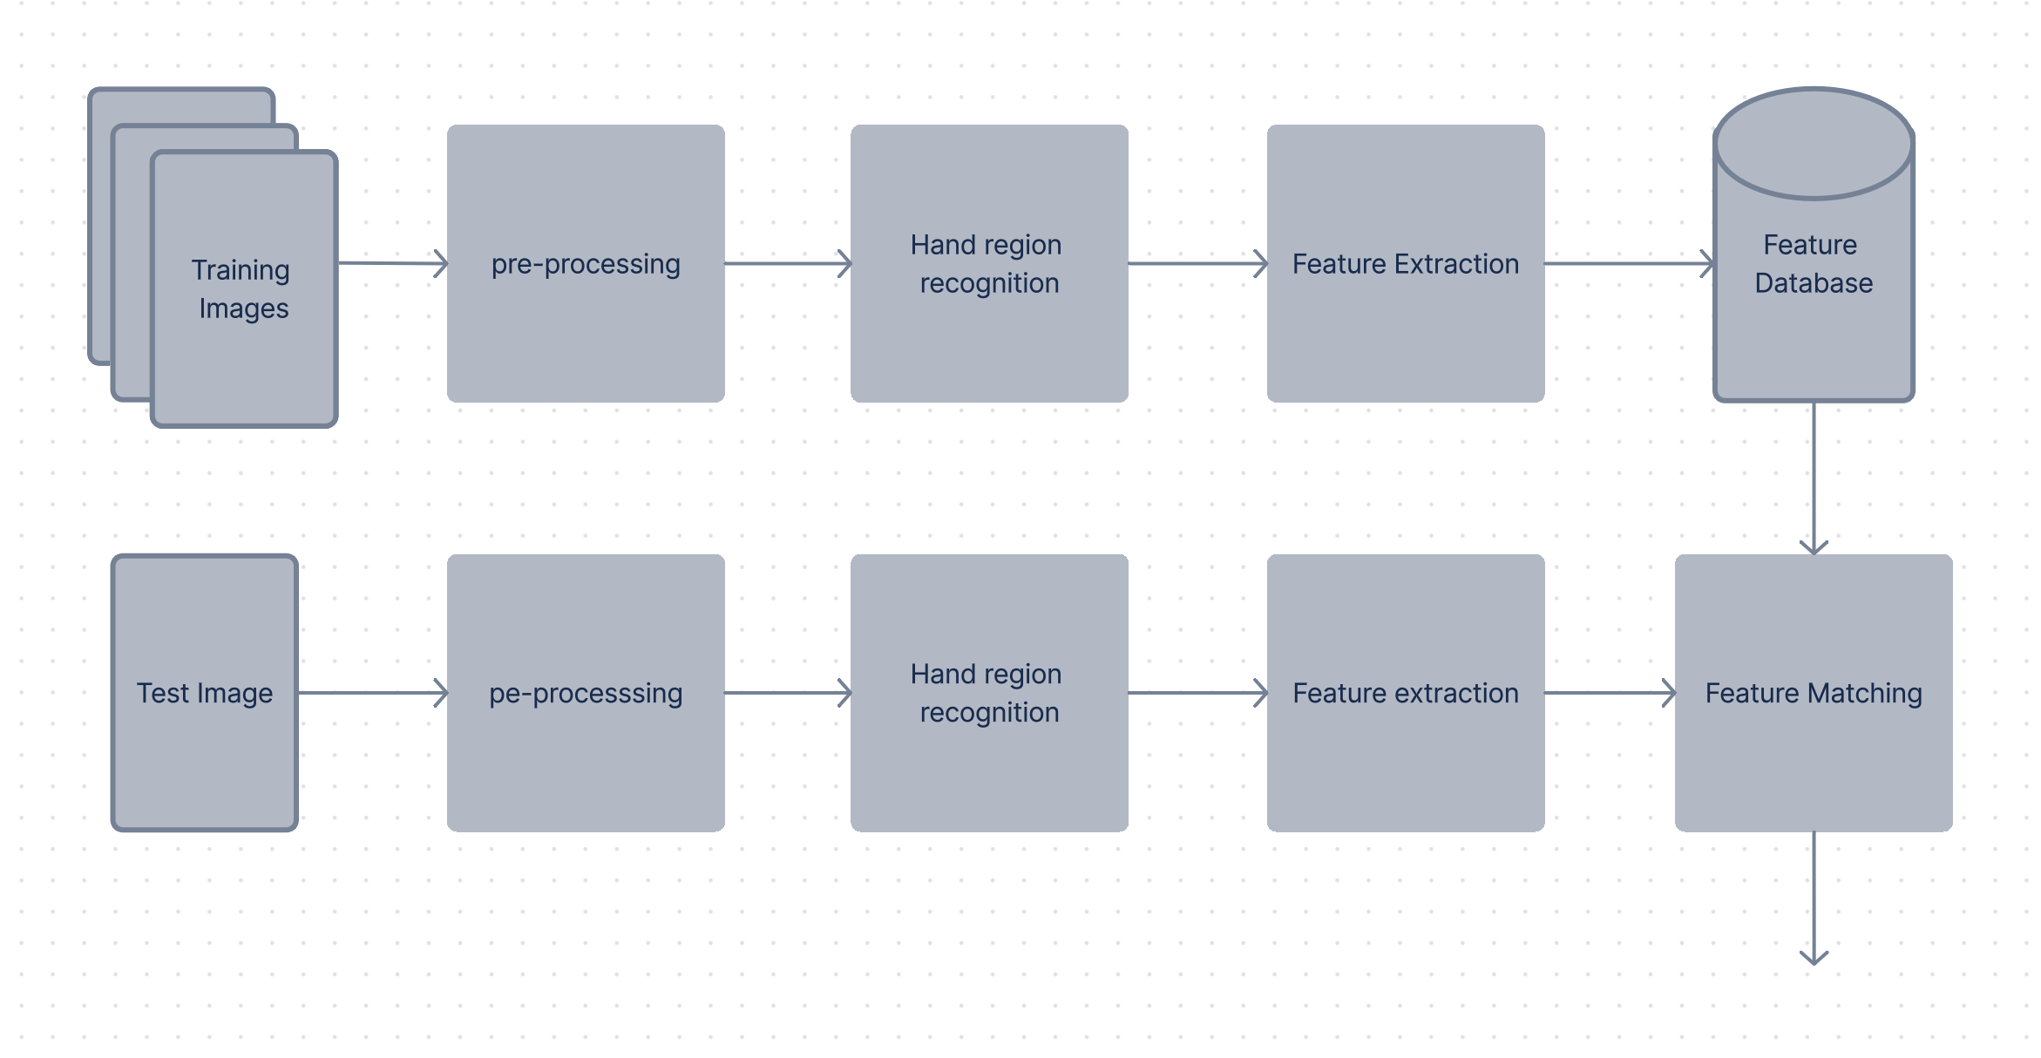
4.DIAGRAMS
4.1 ARCHITECTURE DIAGRAM

Slide 10
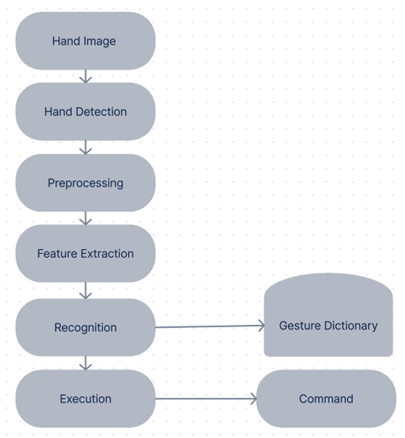
Fig. 4.2 Flowchart

Slide 11
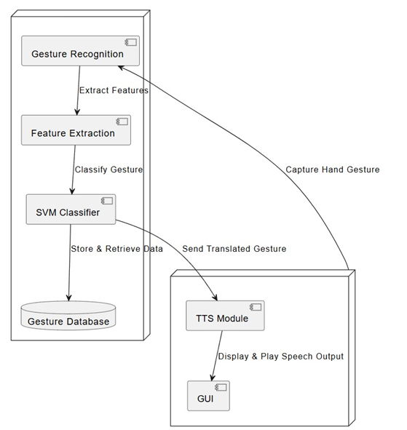
Fig. 4.3: Block diagram

Slide 12
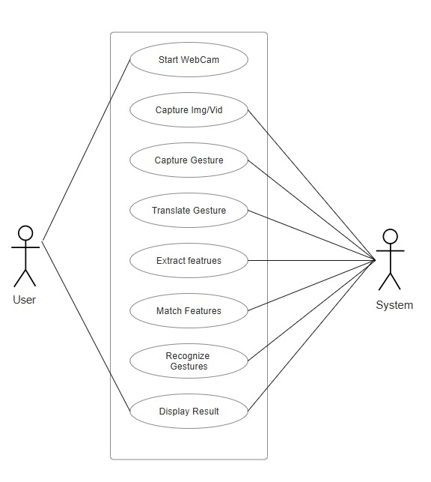
Fig. 4.5: Use case diagram

Slide 13
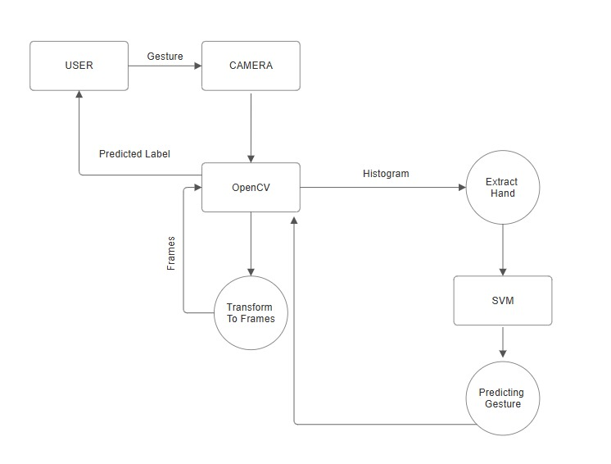
Fig. 4.6: Data Flow diagram

Slide 14
5.METHODOLOGY
The system acquires gesture data using camera sensors or motion-detecting devices.
Preprocessing techniques, including filtering and normalization, are applied to enhance data quality and consistency.
Key features representing distinct gesture characteristics are extracted for classification.
A Support Vector Machine (SVM) model is trained to learn class boundaries and optimize gesture recognition.
Real-time recognition is achieved through efficient processing and optimization techniques.
The system is evaluated using benchmark datasets and performance comparison with existing methods.
The final model is deployed for applications such as sign language recognition and human-computer interaction.

Slide 15
6. DATA GENERATION
Video Organization : Videos are sorted into folders based on action labels for clear classification.
Frame Processing : Each video is processed frame by frame using OpenCV.
Hand Landmark Extraction : MediaPipe’s Hand Tracking module extracts hand landmarks from each frame.
Normalization : Extracted landmarks are normalized to remove positional variations.
Feature Vector Creation : Landmarks are averaged across frames to generate a single feature vector per video.
Standardization : StandardScaler is used to standardize feature vectors for better model performance.
Dataset Splitting : The dataset is divided into training and test sets.
Model Training : An SVM model is trained to classify different hand actions accurately.

Slide 16
7. TRAINING & TESTING
Dataset Split: 80% for training, 20% for testing.
Feature Scaling: Standardized using StandardScaler for better model performance.
Model Training: SVM classifier is trained on hand landmark features to recognize actions.
Model Testing: Evaluated on unseen test data to measure accuracy and generalization.
Model Saving: The trained model and scaler are saved for future use in real-time predictions.

Slide 17
8. IMPLEMENTATION
Install Libraries → Install OpenCV, MediaPipe, TensorFlow, and other required packages.
Capture Hand Gestures → Use OpenCV and MediaPipe to detect hands via webcam.
Extract Features → Capture 21 key hand landmarks for analysis.
Train Model → Collect gesture data and train an SVM for classification.
Recognize Gestures → Use the trained model to identify gestures in real-time.
Convert to Text & Speech → Display detected gestures as text and use TTS for speech output.
Develop GUI (Optional) → Create a user-friendly interface with Tkinter
Test & Optimize → Improve accuracy, handle different lighting conditions, and refine performance.
Future Scope → Add more gestures, multilingual support, and mobile app deployment.

Slide 18
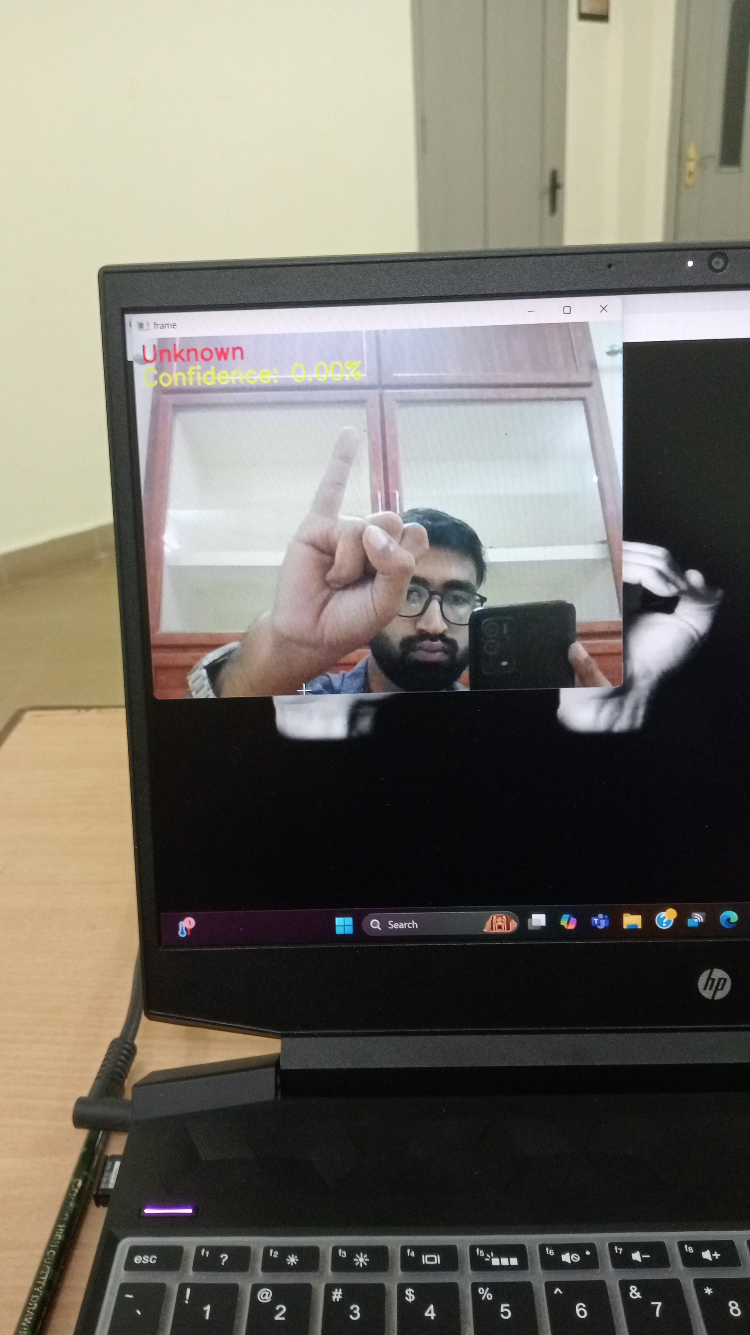
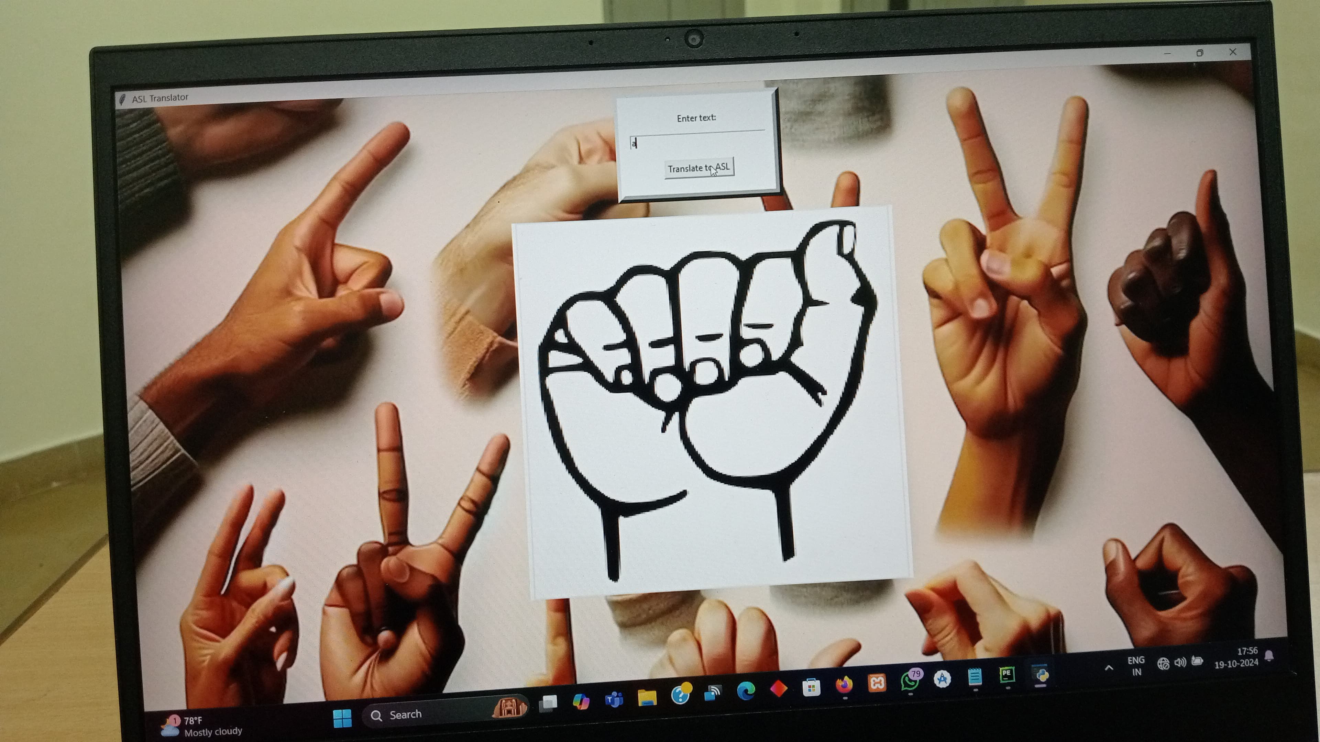
9. RESULTS

Slide 19
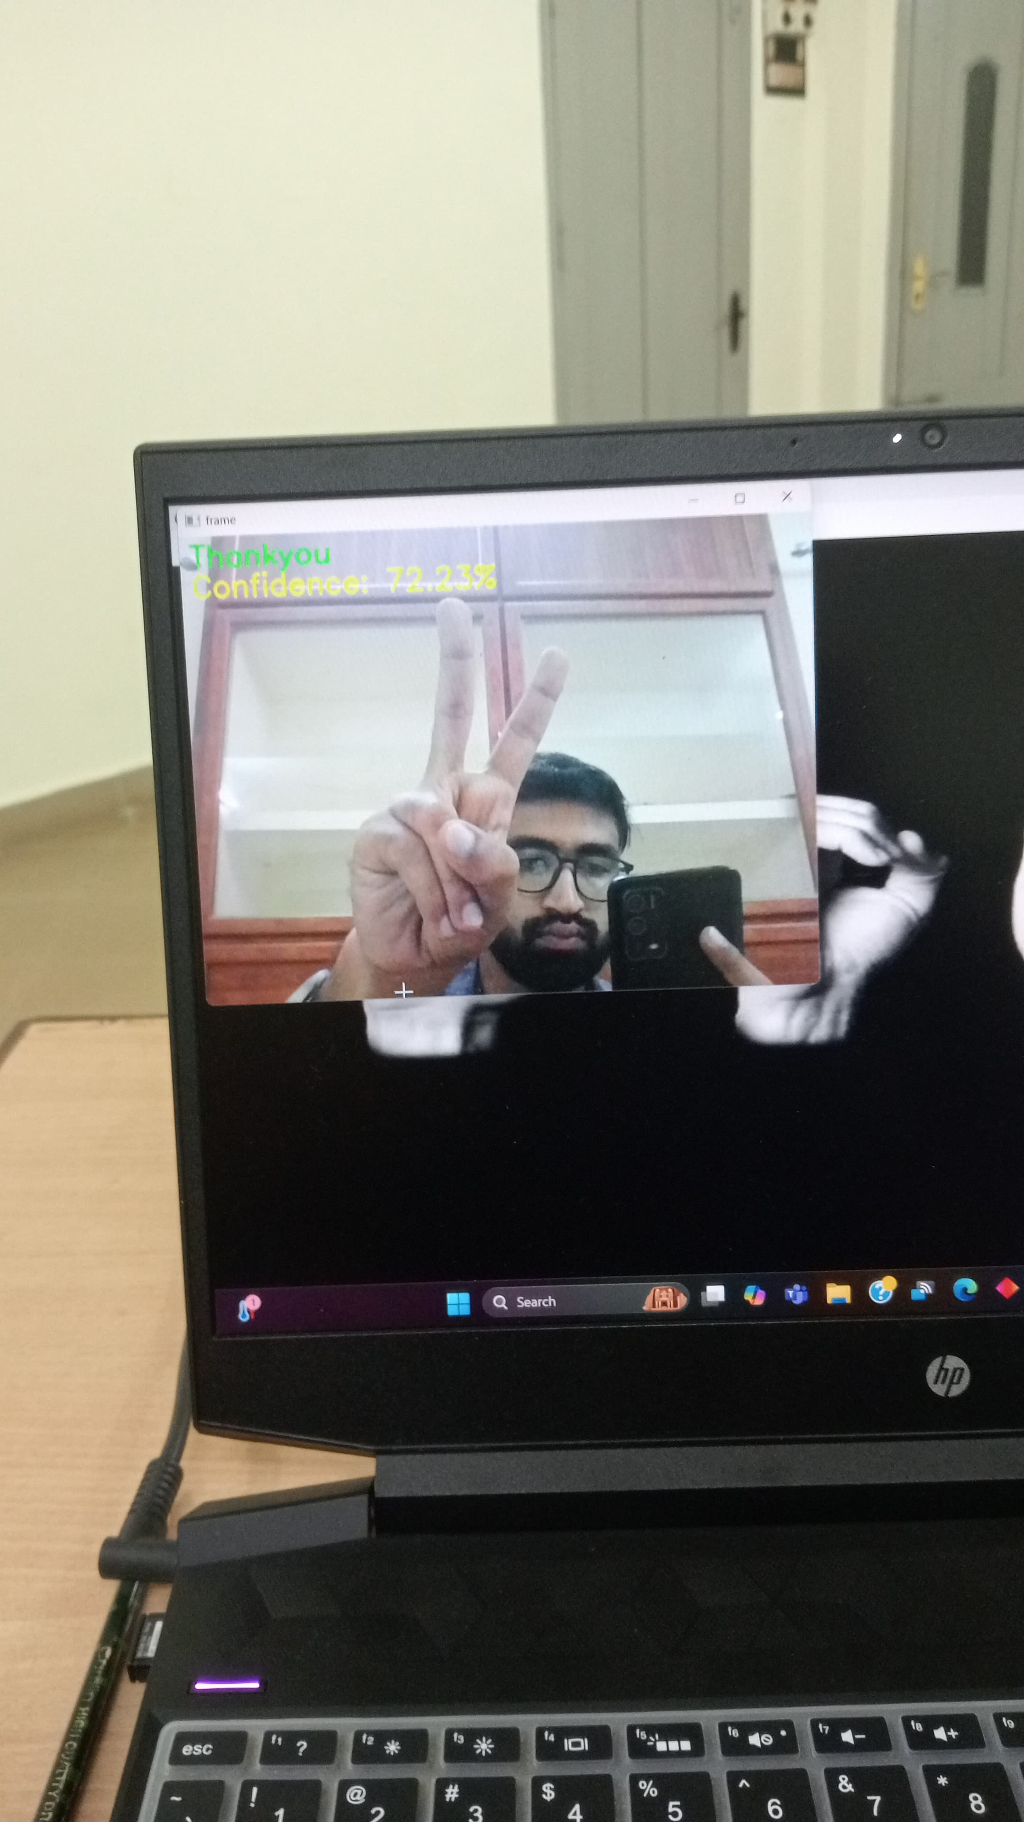
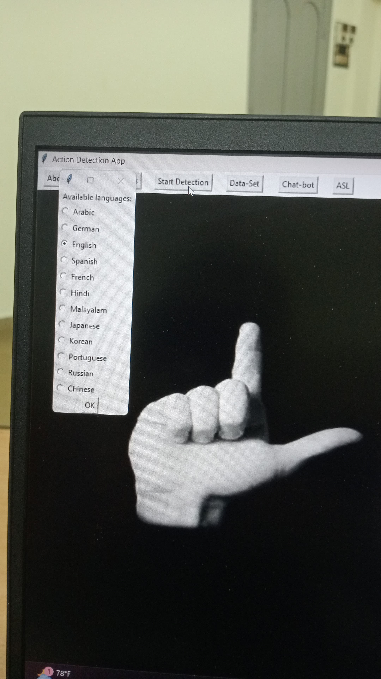

Slide 20
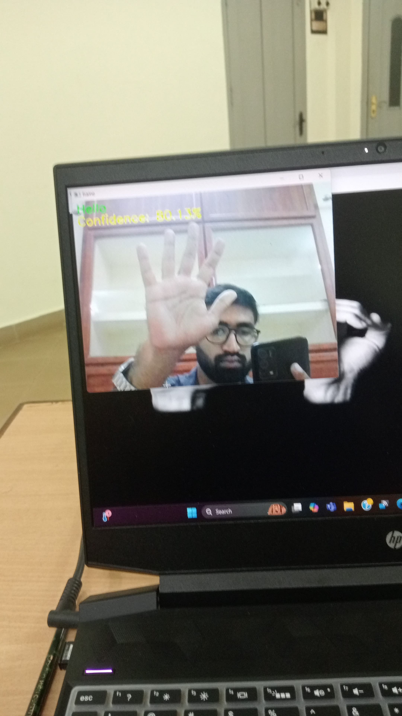
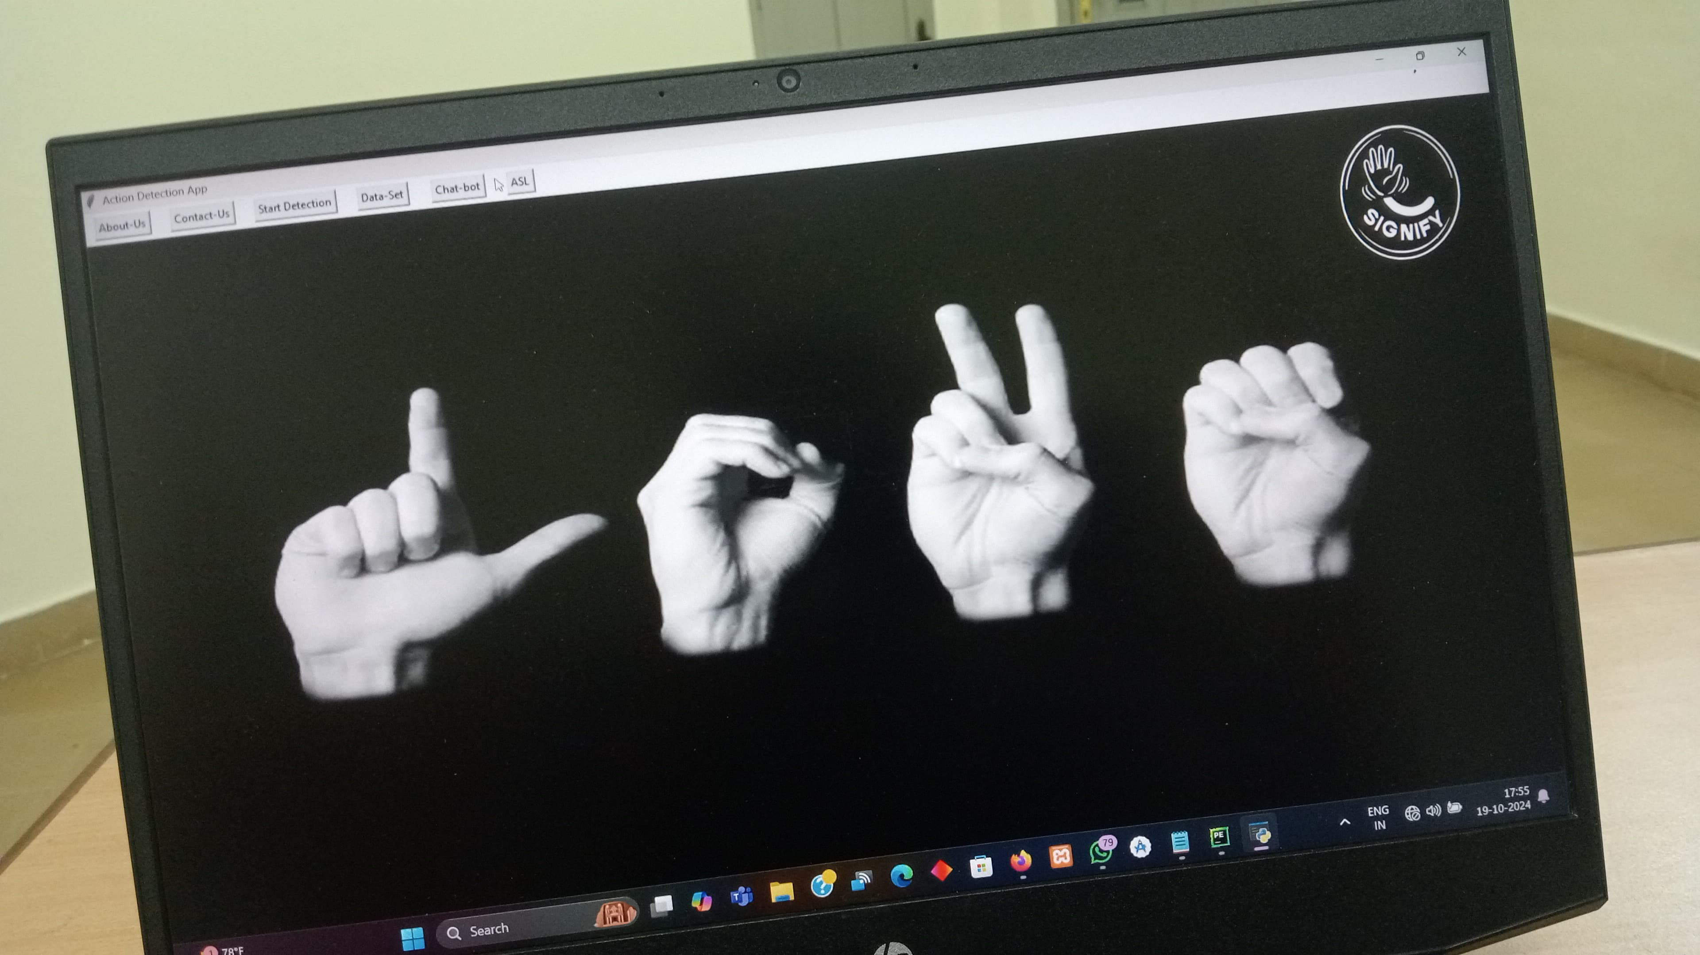

Slide 21
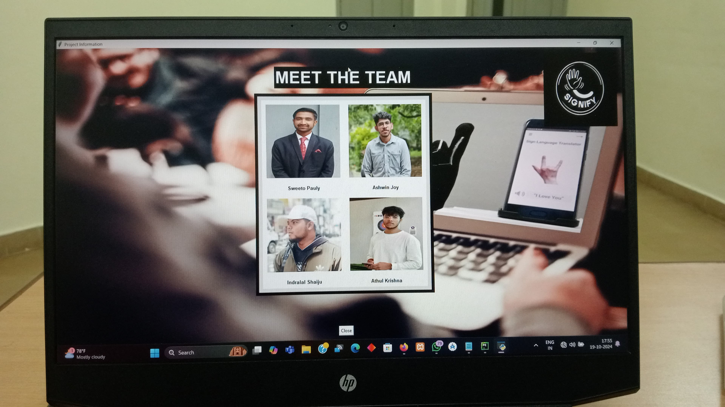

Slide 22
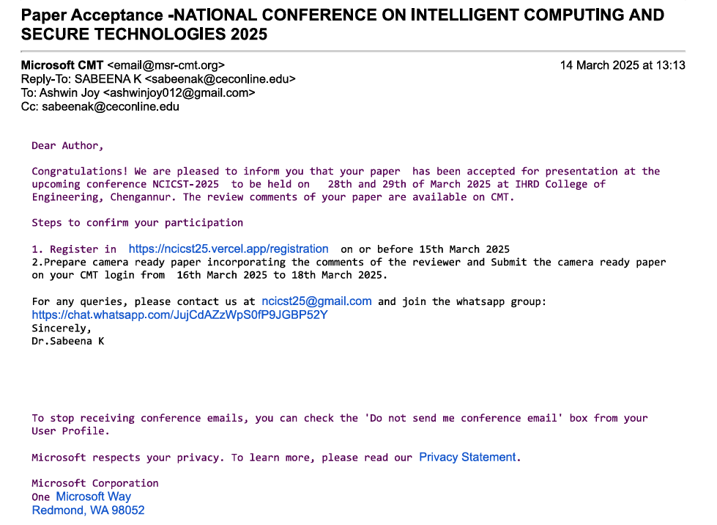

Slide 23
11.SOFTWARE SPECIFICATIONS
Python IDE
Windows 10 Operating System
Python Libraries
Flutterflow
12.HARDWARE SPECIFICATIONS
Processor i3 or i5
8 GB RAM
Hard Disk 500 GB or above

Slide 24
14.CONCLUSION
In short, our main goal for our projects isHand gesture for communicating with the differently abled people in a better wayIn terms of game our main aim is to play the game in a better way than using the physical controller
Overall,
1.The system integrates computer vision and NLP for real-time, accurate gesture classification with minimal latency.
2. The multilingual TTS feature enables seamless communication across different language backgrounds, while the Tkinter GUI and WebSocket ensure a user-friendly experience.
3. With its seamless integration of gesture recognition, multilingual TTS, and an intuitive interface, this app provides a practical and accessible solution for real-time communication, making it valuable for diverse users.
CSE Department, JECC
24
Notes:
24
24
24
24
24

Slide 25
13.FUTURE SCOPE
More Diverse Sign Languages: Expand beyond ASL to include BSL, ISL, and other regional sign languages.
Cloud Level Deployment
AR/VR for Immersive Learning: Use Augmented Reality (AR) for better use
Wearable Devices: Integrate with smart glasses for live subtitle projectionr engagement.
AI-Powered Avatars: Generate signing avatars that help people learn and communicate with sign language users.
CSE Department, JECC
25
Notes:
25

Slide 26
THANK YOU
CSE Department, JECC
26
Notes:
26

